Slide 1
V
I
S
U
A
L
I
S
I
N
G
S
O
L
I
D
S
H
A
P
E
S

Slide 2
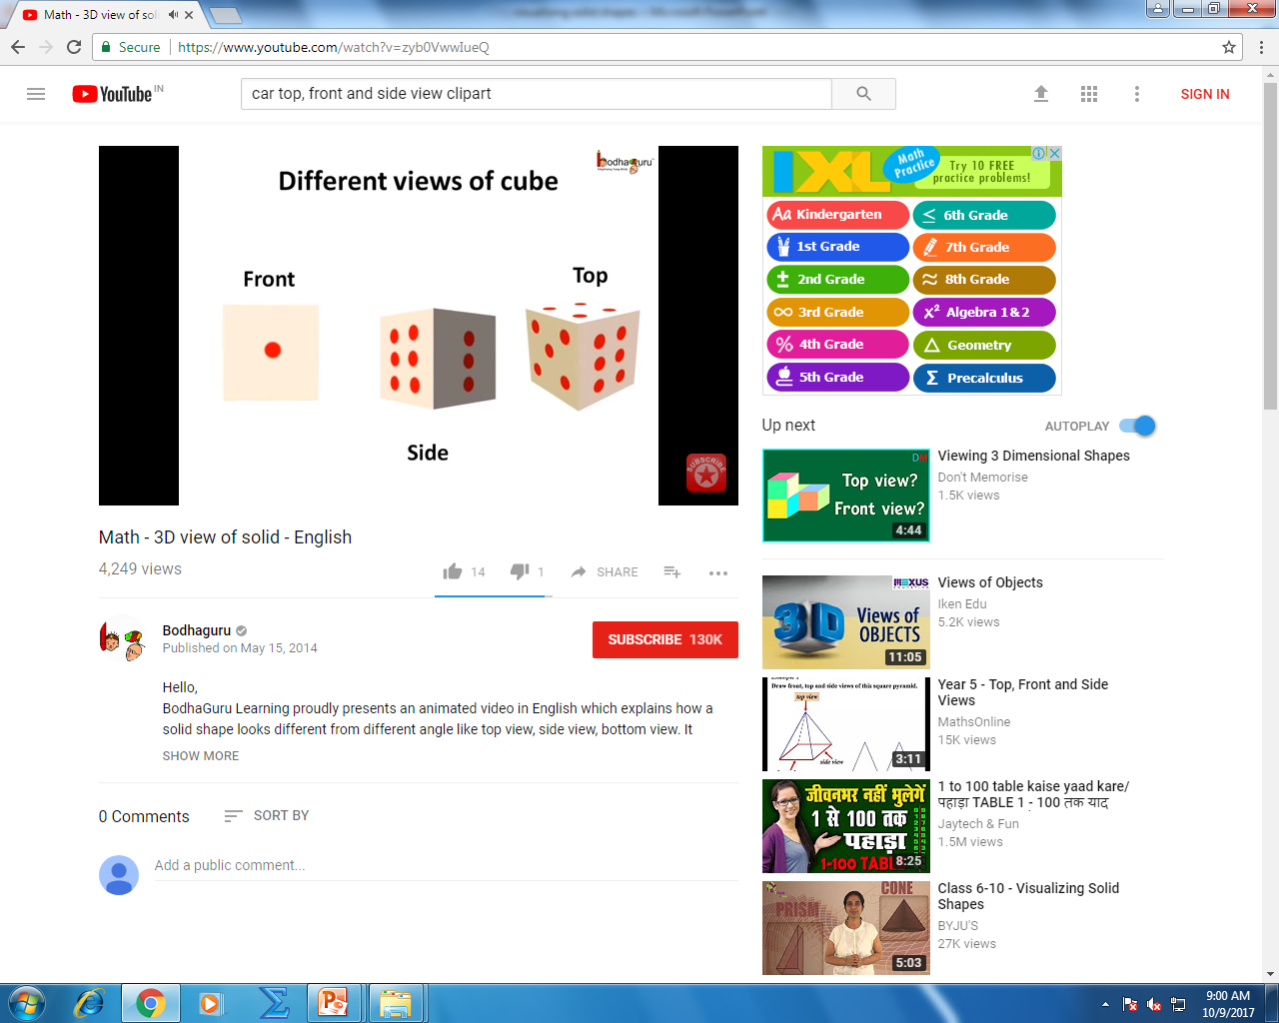
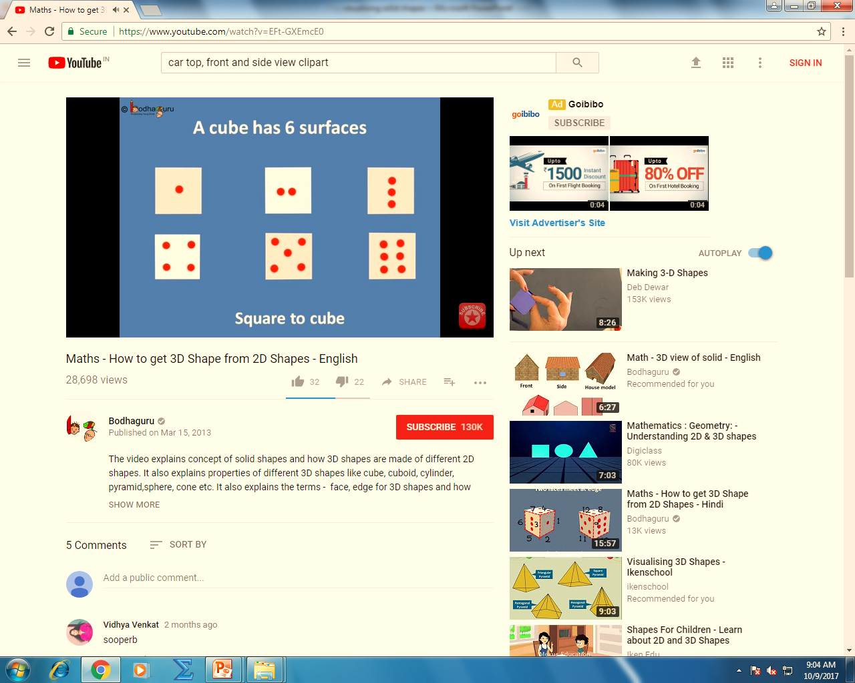

Slide 3
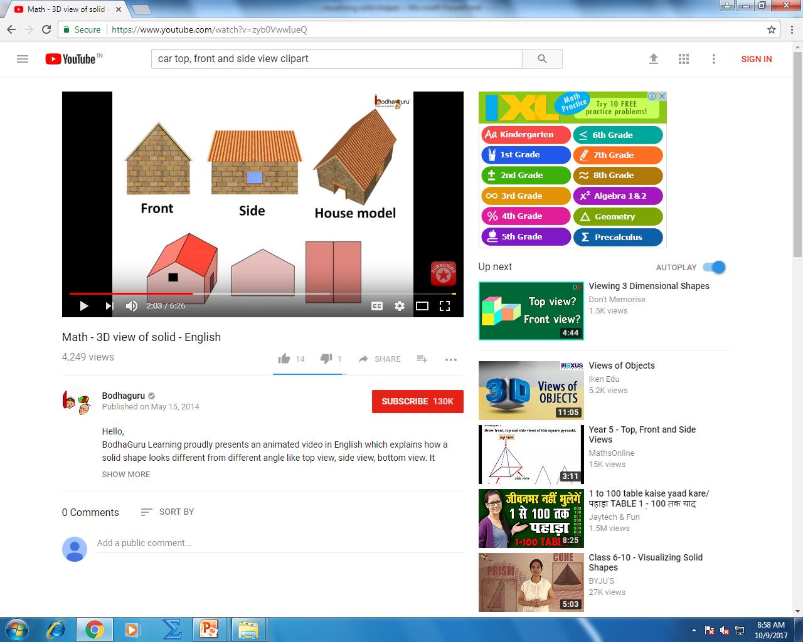
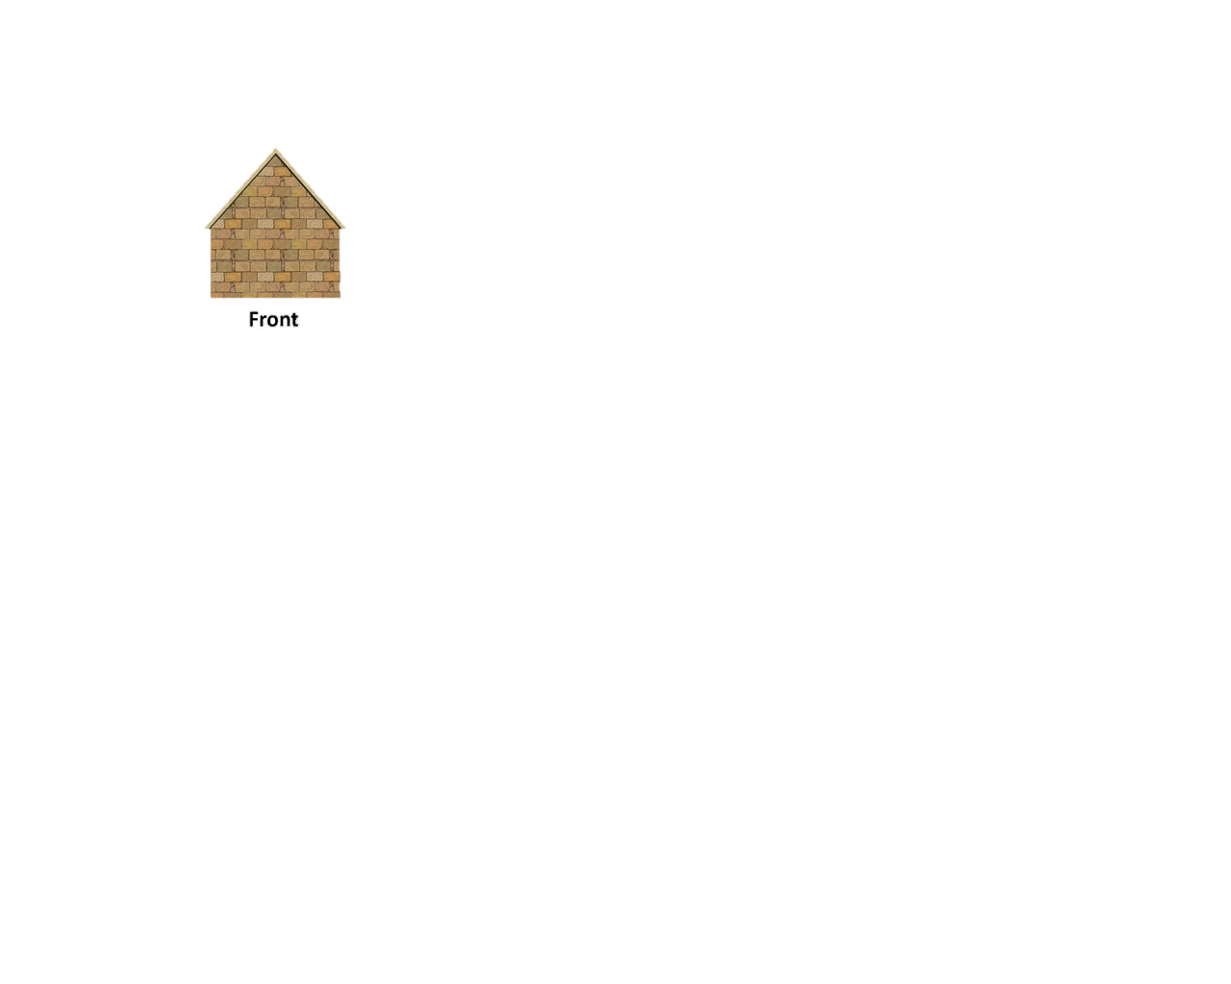
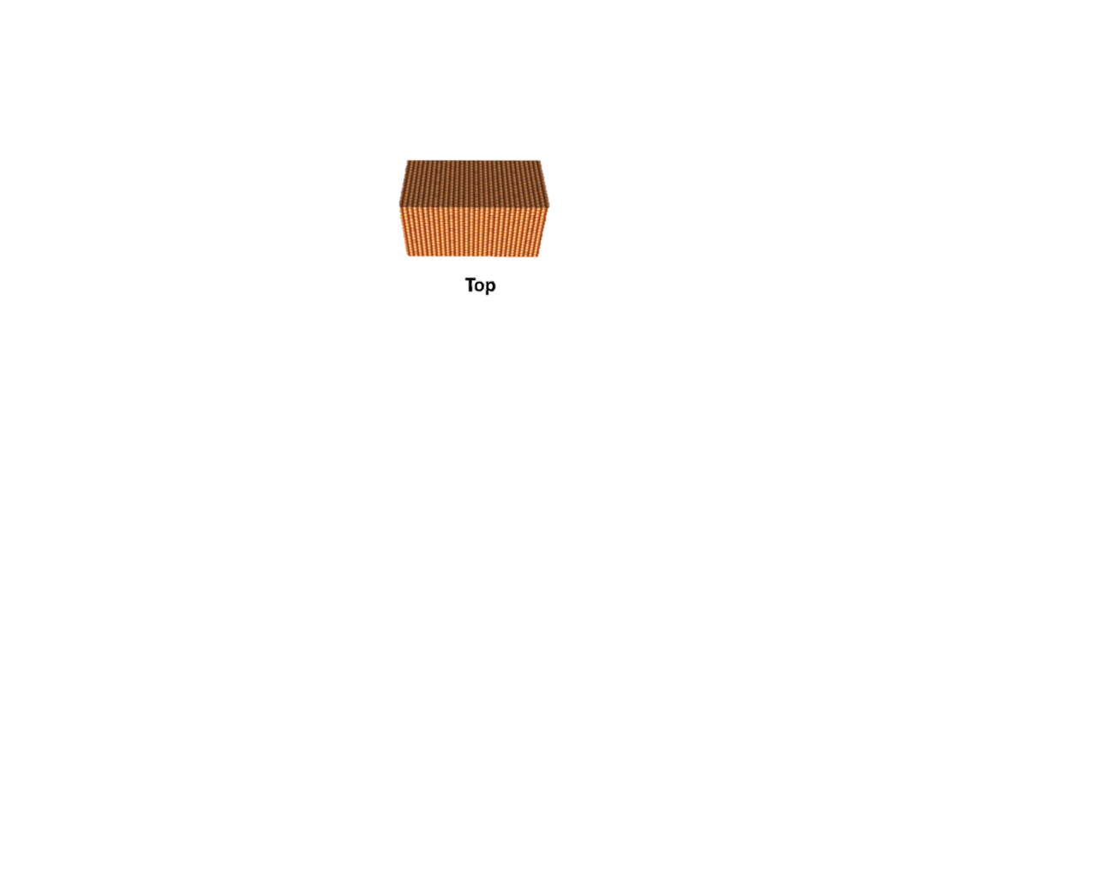
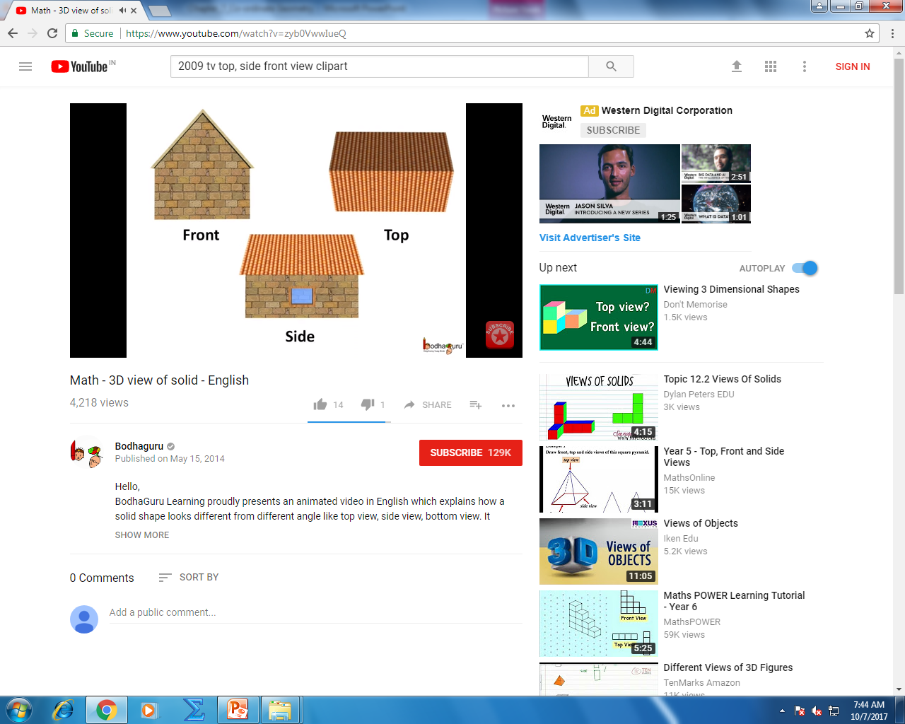

Slide 4
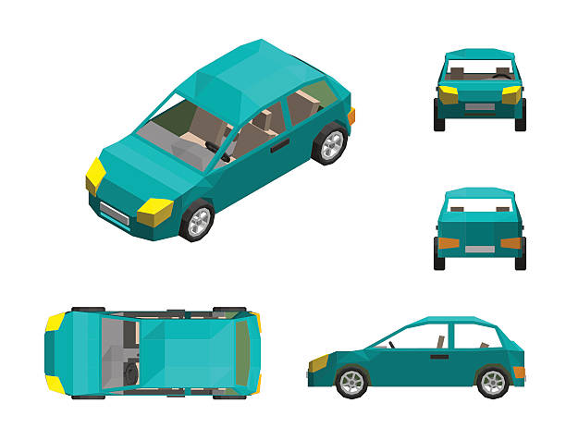
TOP
BACK
Front
Side

Slide 5
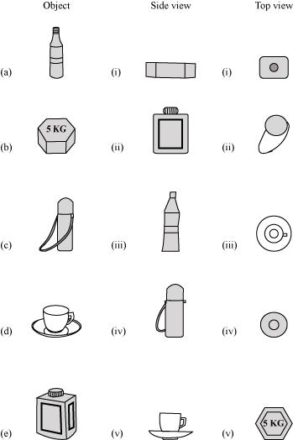

Slide 6
5 kg
5 kg

Slide 7
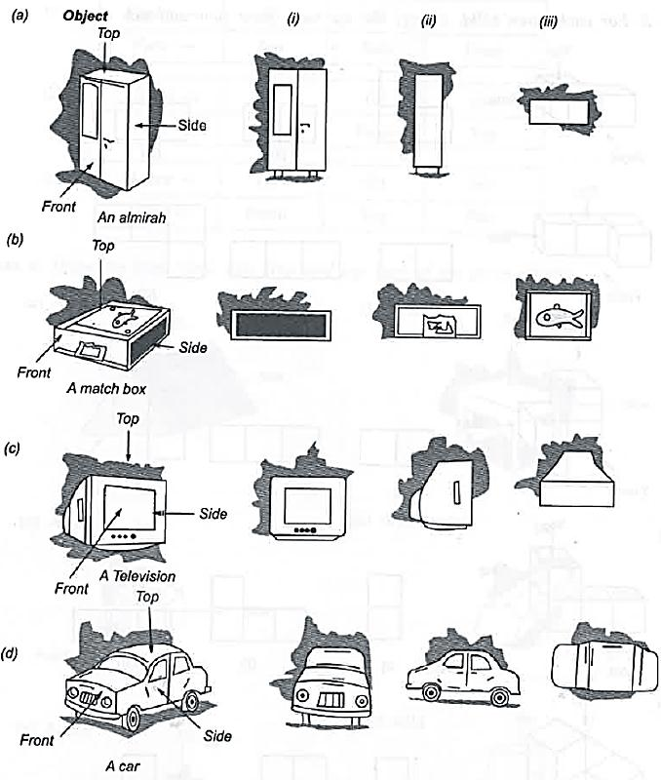
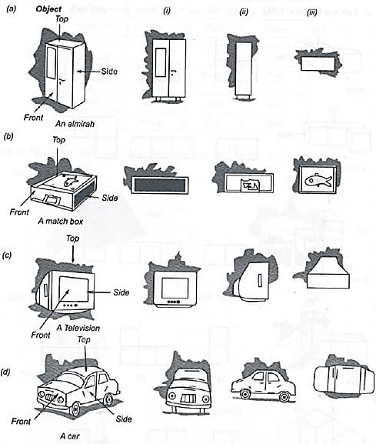

Slide 8
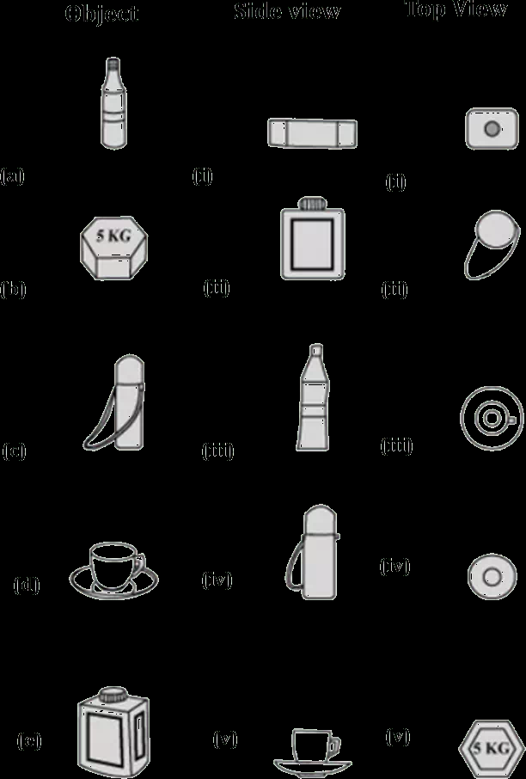
5 kg
5 kg

Slide 9




Square and a Rectangular field with measurements
as given in the figure have the same perimeter.
Which field has a larger area?
Q.
Sol.
Perimeter of Square =
Perimeter of Rectangle
4 × side =
2 (l + b)
Hint :
To find : Breadth
60 m
80 m
4
× 60
=
2
(80
+ b)
∴
2
120
∴
240
=
80
+ b
2
∴
120
=
80
+ b
∴
b
=
120
– 80
∴
b
=
40 m
We know,
Perimeter of Rectangle = 2(l + b)
We know,
Perimeter of Square = 4 × side

Slide 10
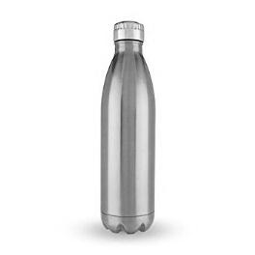
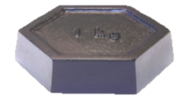
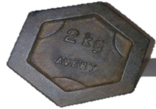



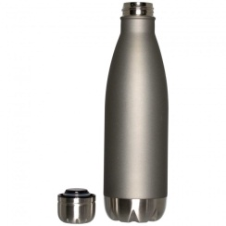
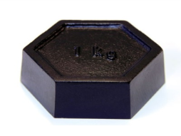
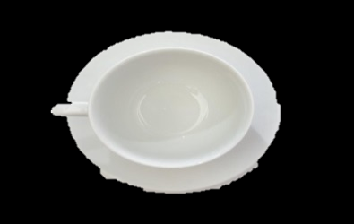
Q.1
For each of the given solid, the two views are given.
Match for each solid the corresponding top and front views
A bottle
Object
Side view
Top view

Slide 11
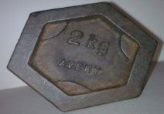

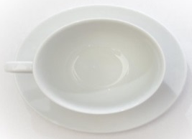
Q.1
For each of the given solid, the two views are given.
Match for each solid the corresponding top and front views
A bottle
Object
Side view
Top view

Slide 12
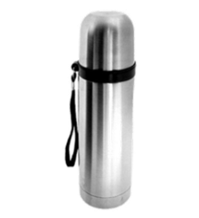

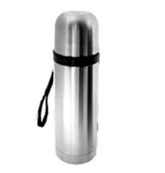
Q.1
For each of the given solid, the two views are given.
Match for each solid the corresponding top and front views
A Weight
Object
Side view
Top view

Slide 13
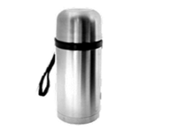
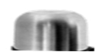

Q.1
For each of the given solid, the two views are given.
Match for each solid the corresponding top and front views
A Cup & saucer
Object
Side view
Top view

Slide 14


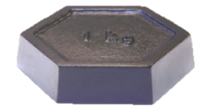


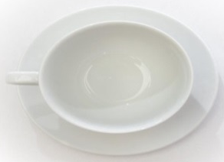
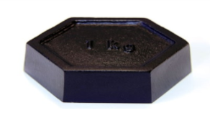
Q.1
For each of the given solid, the two views are given.
Match for each solid the corresponding top and front views
A Container
Object
Side view
Top view

Slide 15







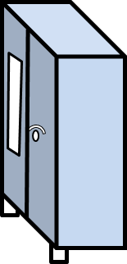



For each of the given solid, the three views are given.
Identify for each solid the corresponding top, front
and side views
Q.1
Top
Front
Side
Top
Front
Side

Slide 16


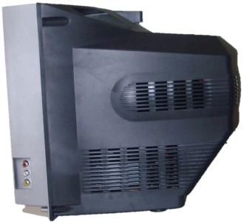





Identify for each solid the corresponding top, front and side views
Top
Front
Side
Top
Front
Side

Slide 17
Q
For each given solid, identify the top view, side view & front view.
Top
(a)
Side
✓
✓
✓
Front
(i)
(ii)
(iii)
Top
(b)
✓
✓
(ii)
(iii)
✓
Side
(i)
Front

Slide 18
Q
For each given solid, identify the top view, side view & front view.
Top
(c)
✓
✓
✓
(i)
(ii)
(iii)
Front
Side
(d)
Top
✓
✓
✓
(i)
(ii)
(iii)
Front
Side

Slide 19

EXERCISE
3. For each given solid, identify the top view, front view and side view.
Top
(e)
✓
✓
✓
Top
Side
Front
Side
Front

Slide 20

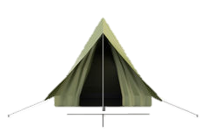

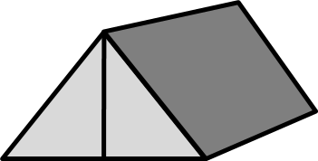
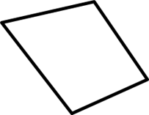
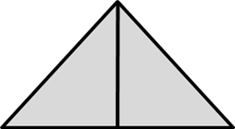

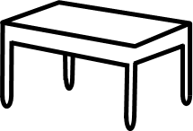

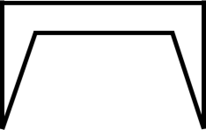
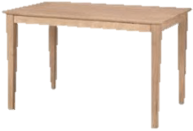
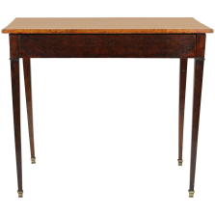

EXERCISE
4. Draw the front view, side view and top view of the given objects:
Sr
No
Front view
side view
Top view
Object
a
b

Slide 21
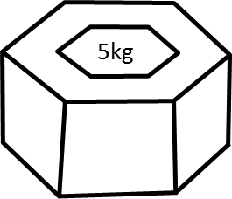
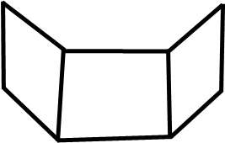





EXERCISE
4. Draw the front view, side view and top view of the given objects:
Sr
No
Front view
side view
Top view
Object
c
d

Slide 22
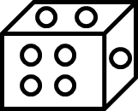





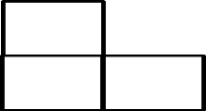
EXERCISE
4. Draw the front view, side view and top view of the given objects:
Sr
No
Front view
side view
Top view
Object
e
f

Slide 23

Q
Can a polygon have for its faces:
i. 3 Triangles ?
Sol.
No, a polyhedron cannot have 3 triangles for its faces.

Slide 24
EXERCISE
1. Can a polygon have for its faces:
i. 3 Triangles ?
Sol.
No, a polyhedron cannot have 3 triangles for its faces
ii. 4 triangles
Sol.
Yes, a polyhedron can have four
triangles which is known as pyramid
on triangular base.
iii. a square and four triangles
Sol.
Yes, a polyhedron has its faces a square and four triangles which makes a pyramid on square base.

Slide 25
EXERCISE
2. Is it possible to have a polyhedron with any given number of faces?
(Hint: Think of a pyramid)
Sol.
It is possible, only if the number of faces are greater than
or equal to 4.

Slide 26


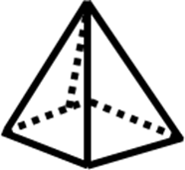

EXERCISE
3. Which are prisms among the following:
i
ii
iii
iv
Sol.
Figure (ii) unsharpened pencil and figure (iv) a box are prisms.

Slide 27
EXERCISE
4. How are prisms and cylinders alike?
Sol.
A prism becomes a cylinder as the number of sides of its base
becomes larger and larger.
ii. How are pyramids and cones alike?
Sol.
A pyramid becomes a cone as the number of sides of its base becomes larger and larger.

Slide 28
5. Is a square prism same as a cube? Explain.
Sol.
No, it can be a cuboid also.

Slide 29

Q
Verify Euler’s formula for these solids.
1
Sol.
F
=
7,
V
=
10,
E
=
15
Euler’s Formula
F + V – E = 2
3
5
L.H.S
=
F
+
V
–
E
6
7
4
=
7
+
10
–
15
=
17
–
15
2
=
2
L.H.S
=
R.H.S.
(i)

Slide 30
Q
Verify Euler’s formula for these solids.
2
1
3
Sol.
F
=
9,
V
=
9,
E
=
16
Euler’s Formula
F + V – E = 2
4
L.H.S
=
F
+
V
–
E
=
9
+
9
–
16
6
7
8
9
=
18
–
16
=
2
5
R.H.S
=
L.H.S
(ii)

Slide 31

Q
Using Euler’s formula, find the unknown:
Faces
8
?
5
20
Vertices
6
?
12
Edges
12
9
?
Sol.
In first column,
F
=
?,
V
=
6
and
E
=
12
Using Euler’s formula,
F
+
V
–
E
=
2
F
+
6
–
12
∴
=
2
∴
F
–
6
=
2
∴
F
=
2
+
6
∴
F
=
8
Hence there are 8 faces.

Slide 32
Q
Verify Euler’s formula for these solids.
Faces
8
5
20
Vertices
6
6
?
12
Edges
12
9
?
Sol.
In second column,
F
=
5,
V
=
?
and
E
=
9
Using Euler’s formula,
F
+
V
–
E
=
2
∴
5
+
V
–
9
=
2
∴
V
–
4
=
2
∴
V
=
2
+
4
∴
V
=
6
Hence there are 6 vertices.

Slide 33
Q
Verify Euler’s formula for these solids.
Faces
8
5
20
Vertices
6
6
12
Edges
12
9
?
30
Sol.
In third column,
F
=
20,
V
=
12
and
E
=
?
Using Euler’s formula, we see
F
+
V
–
E
=
2
F
+
V
–
E
=
2
∴
20
+
12
–
E
=
2
∴
32
–
E
=
2
E
=
32
2
∴
–
∴
E
=
30
Hence there are 30 edges.

Slide 34
Q
Can a polyhedron have 10 faces, 20 edges and 15 vertices ?
Sol.
F
=
10,
V
=
15
and
E
=
20
Euler’s Formula
F + V – E = 2
Then, we know Using Euler’s formula,
L.H.S
=
F
+
V
–
E
=
10
+
15
–
20
=
25
–
20
L.H.S
=
5
∴
R.H.S
=
2
L.H.S
≠
R.H.S
Polyhedron having 10 faces, 20 edges and 15 vertices does not exist.

